Slide 1




IBM Technical Exchange DMN Going Beyond the Basics 24th May 2023
Reinhold Engelbrecht
Techsales Leader EMEA
IBM Business Automation
Nigel Crowther
RPA and Open Edition SME EMEA
IBM Business Automation
Fadi Sandakly
Decisions and Cloud Pak SME EMEA
IBM Business Automation
Material: https://ibm.box.com/v/2023-05-24DMNBeyondBasics

Slide 2

Agenda (times in CET)
09:30 – 09:35 Welcome 09:35 – 09:45 Why DMN (Presentation) 09:45 – 10:00 DMN Patterns (Presentation) 10:00 – 11:30 Lab 1-4 – DMN Patterns (Lab)
11:30 – 11:40 Approaches to implementing Excel 11:40 – 11:45 Hit policies (Presentation) 11:45 – 12:00 Lab 5 – Hit Policies (Lab) 12:00 – 12:05 Advanced Feel
12:05 – 12:25 Lab 6 Advanced Feel (Lab) 12:25 – 12:30 Q&A and closing

Slide 3
Why DMN
What is DMN?
DMN stands for Decision Model and Notation. DMN is a modelling language for business rules.
Why use DMN?
DMN minimizes the risk of misunderstandings between business analysts and developers and allows the business to drive changes.
Standard
DMN is owned by an institution (OMG). OMG established standards such as BPMN and UML. The DMN standard is supported by many commercial products; DM, ADS, Camunda, DMN Modeller ..
Execution
DMN decision models can be executed. We will build and execute in KIE Sandbox
What is FEEL
FEEL (Friendly Enough Expression Language) is the underlying low code language for DMN
Notes:
https://ibm.ent.box.com/folder/207663729805?v=2023-05DMNBeyondBasics

Slide 4

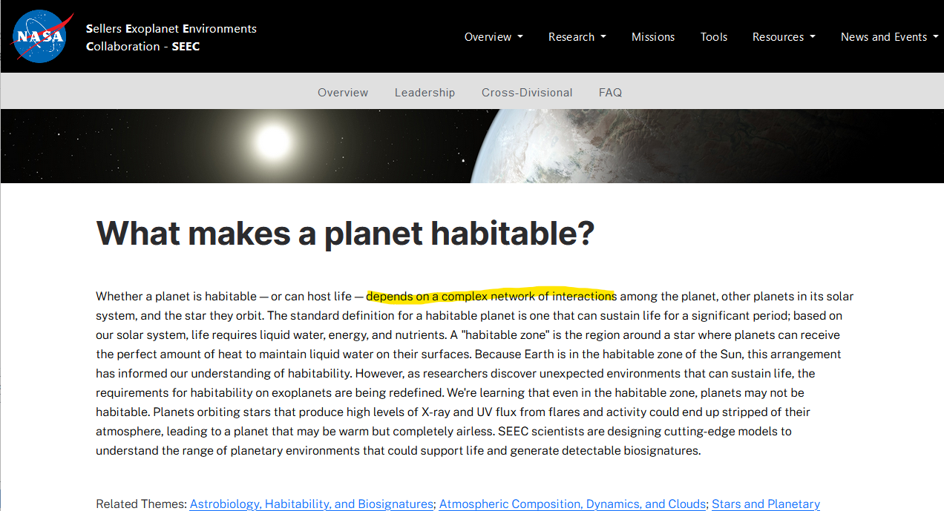
DMN Patterns – Planet Habitability Use Case
Notes:
https://ibm.ent.box.com/folder/207663729805?v=2023-05DMNBeyondBasics

Slide 5

DMN Patterns – Planet Habitability Use Case
Oxygen
Co2,
Methane
Max/Min Temp
Gravity
Air Pressure
Radiation
Eccentricity
Sunlight
Uninhabitable
Possibly habitable
Habitable
Notes:
https://ibm.ent.box.com/folder/207663729805?v=2023-05DMNBeyondBasics

Slide 6
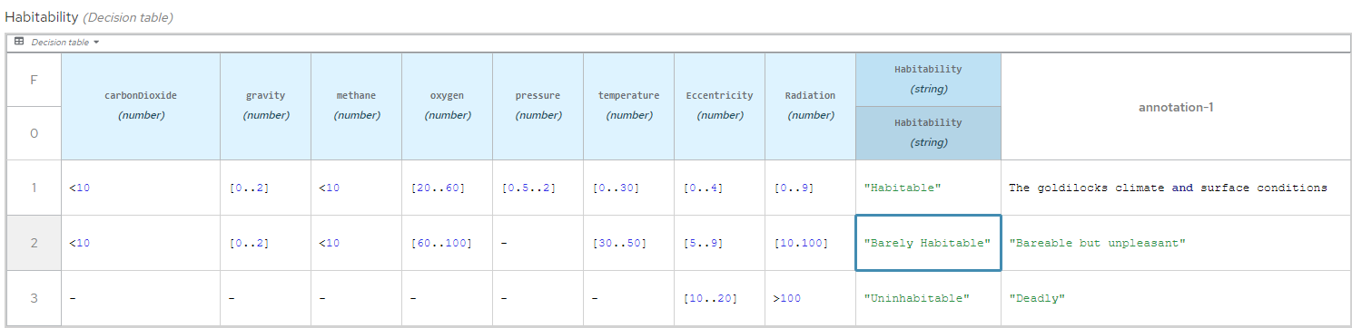
Single Wide Decision Table
Anti Pattern!
Notes:
https://ibm.ent.box.com/folder/207663729805?v=2023-05DMNBeyondBasics

Slide 7
Single Wide Decision Table
Anti Pattern!
Total rows = Number of condition cols * number of outcomes
24 = 8 * 3 [Habitability]
70000 = 70 * 1000 [Insurance Segmentation rules]
Notes:
https://ibm.ent.box.com/folder/207663729805?v=2023-05DMNBeyondBasics

Slide 8
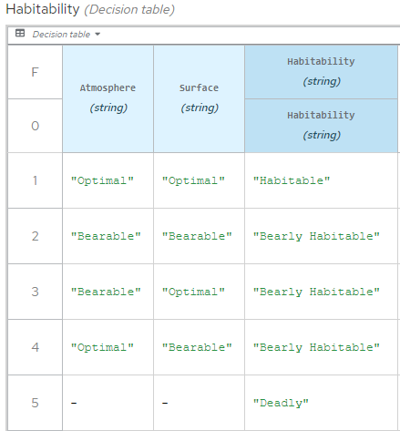
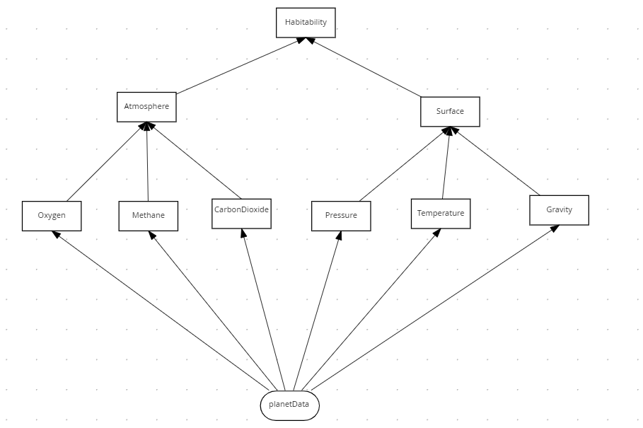
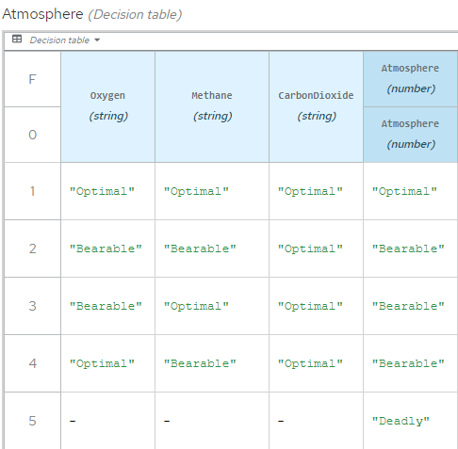
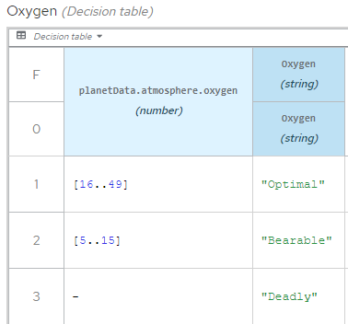
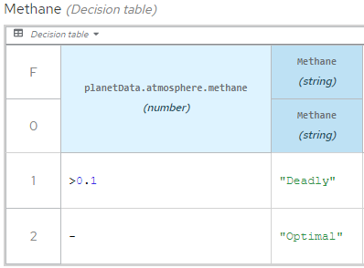
Divide and Conquer Pattern

Slide 9
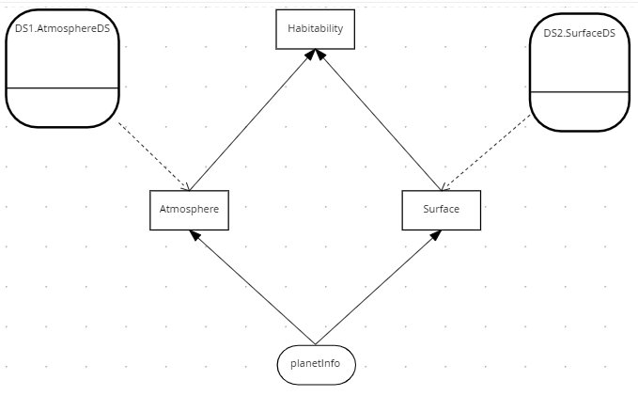
Tiered Service Pattern
The DMN defined in the previous lab was confined to a single file.
This is a problem because:
The DMN cannot be edited simultaneously by several people.
The DMN cannot be reused in other decisions.
The Tiered Service Pattern fixes this.
Decision
Service
Decision
Service

Slide 10

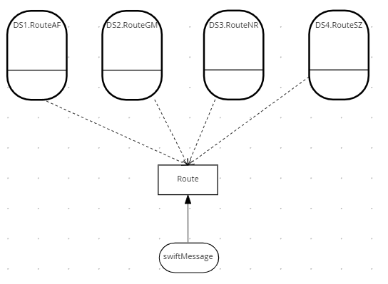
The Index Pattern
The Index Pattern
The Divide and Conquer Pattern does not work with many rules and few conditions. Use the Index Pattern for this.

Slide 11
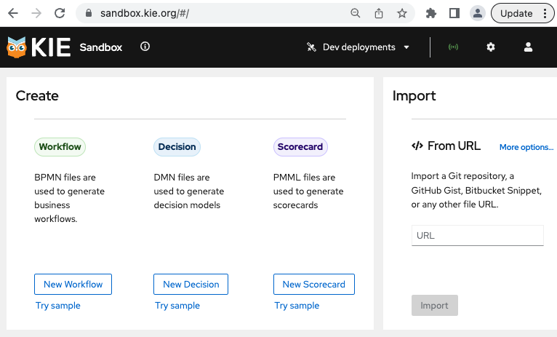
Let’s begin the Hands-on Exercises
Two pre-requisites:
Chrome Browser: https://sandbox.kie.org
Install KIE Sandbox Extended Services. See Appendix A: Installing KIE Sandbox Extended Services
Lab guide (and other material)
https://ibm.box.com/v/2023-05-24DMNBeyondBasics
Option B: If you cannot do a local install of KIE Sandbox Extended Services on your machine, raise it in the chat. We assign a remote environment to you! (e.g., ussouth.techzone-services.com:24309)
Any questions?

Slide 12
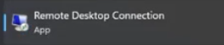
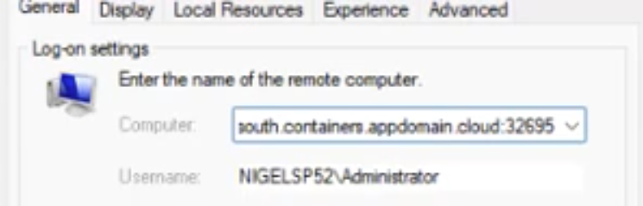
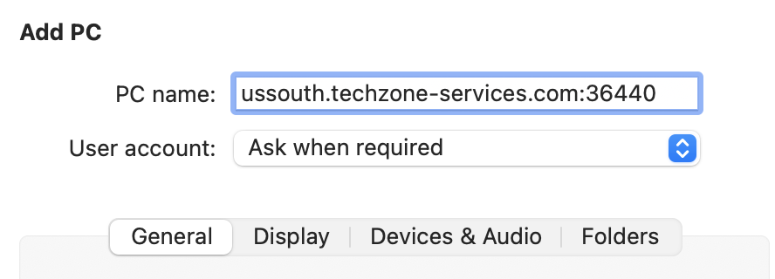
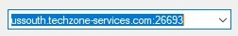
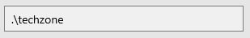
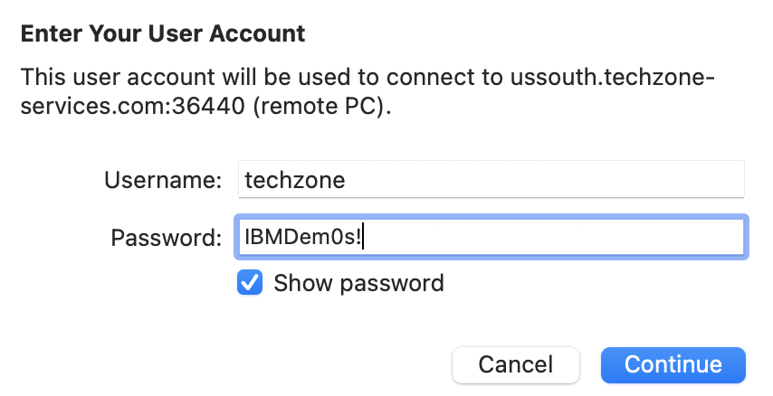
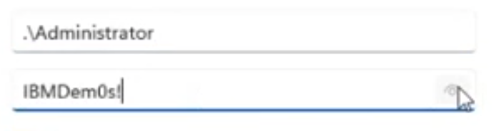
Option B: Start your Remote Desktop Application
Any questions?
Windows
Paste your host and port information
Enter the user and password
Mac
Click on Plus sign to add a new remote computer
Paste your host and port information
Enter the user and password

Slide 13
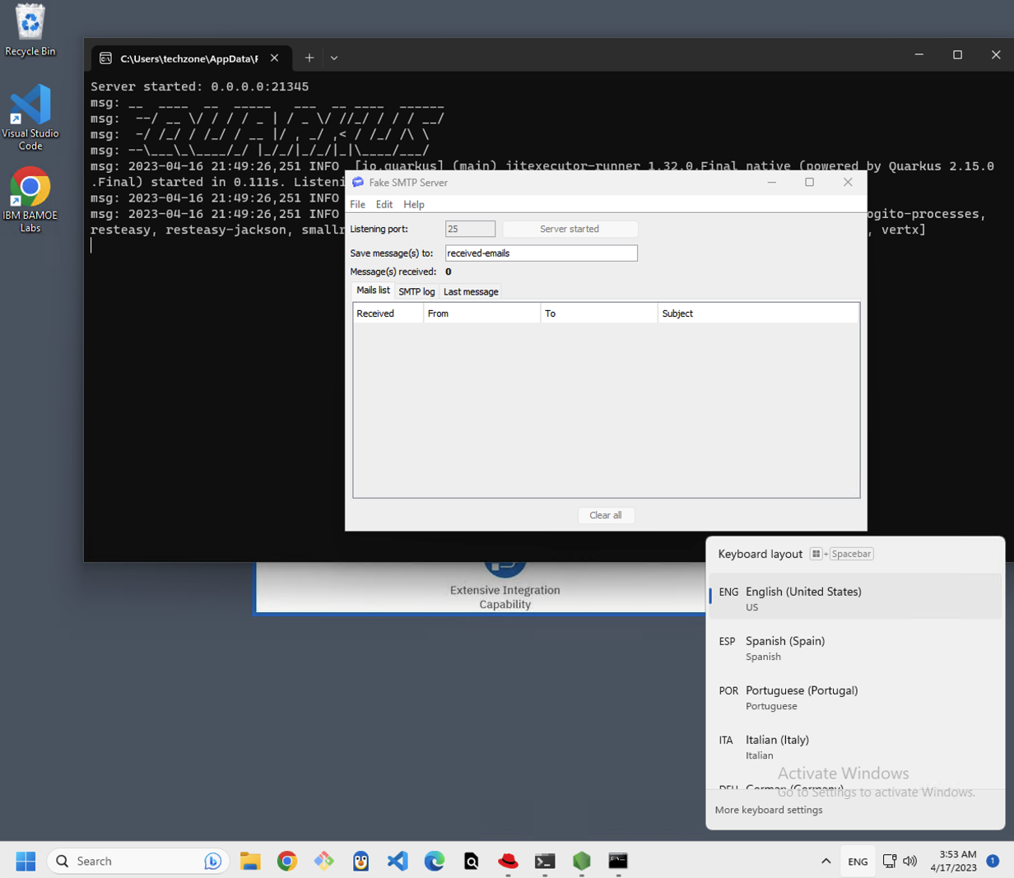
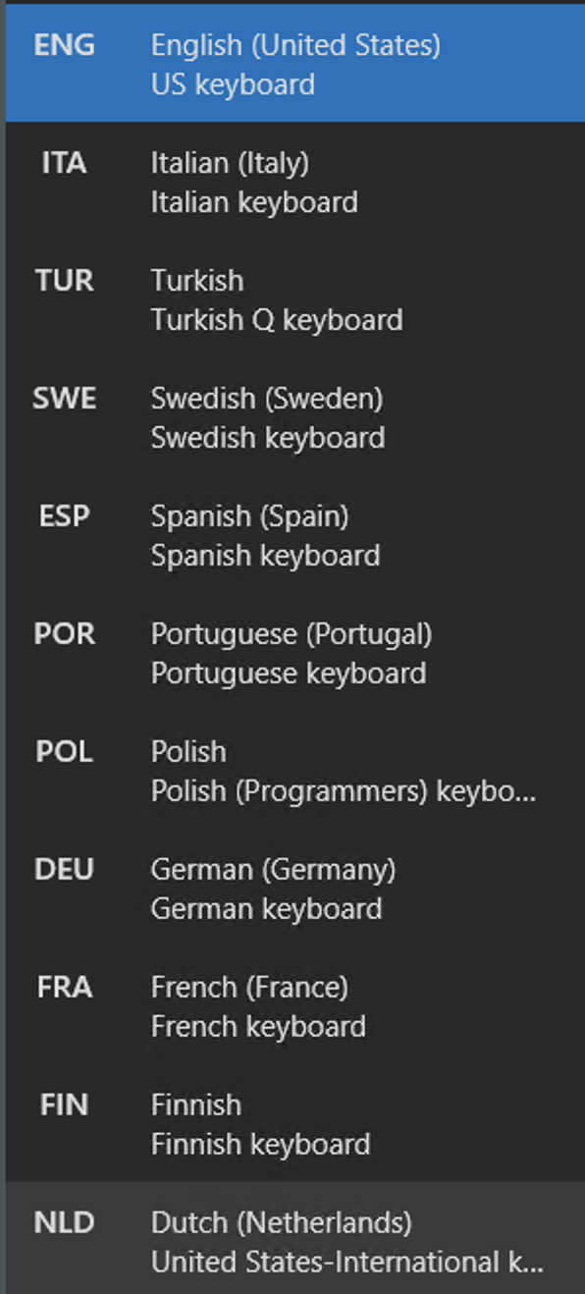
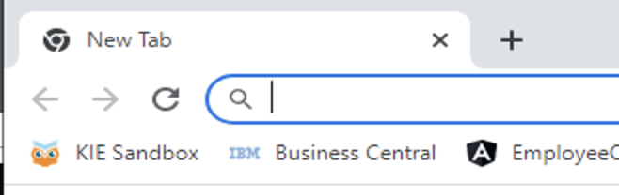
After having connected to the image
Any questions?
Change the keyboard on the remote image to your local one
Bottom right corner
Open Chrome browser and go to KIE Sandbox
Lab guide (and other material)
https://ibm.box.com/v/2023-05-24DMNBeyondBasics

Slide 14
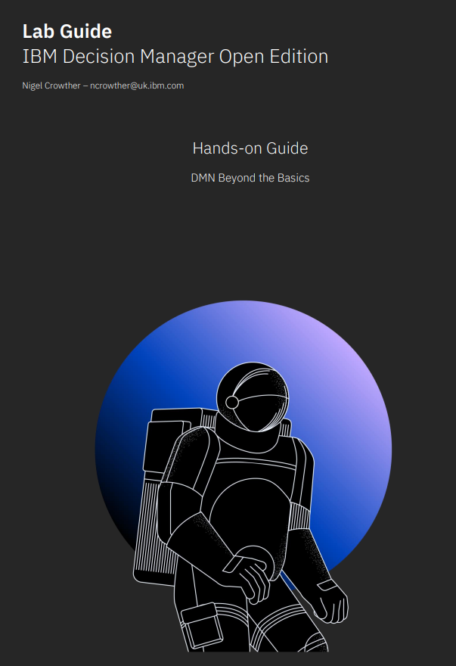
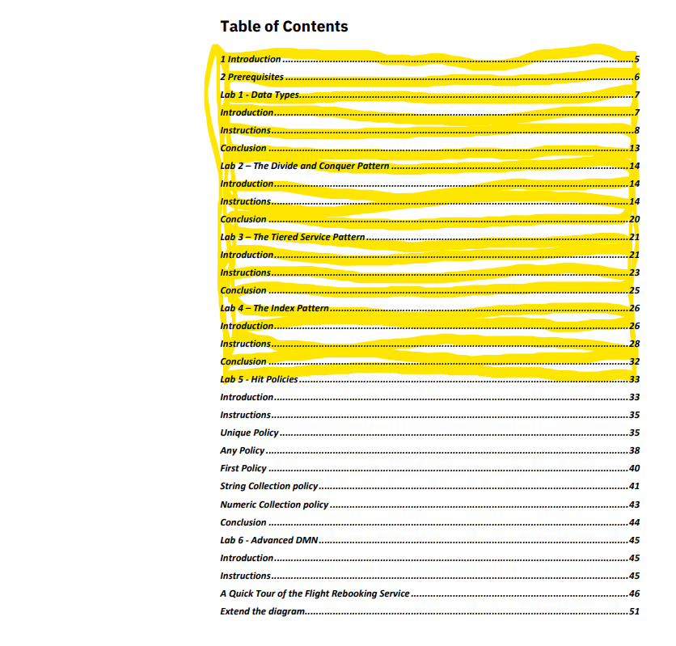
IBM Technical Exchange 10:00 – 11:30 Labs 1 to 4 - Patterns
In these labs you will learn real world patterns and techniques to build scalable and robust decision services.
https://ibm.box.com/v/2023-05-24DMNBeyondBasics
Reconvene 11:30 CET

Slide 15
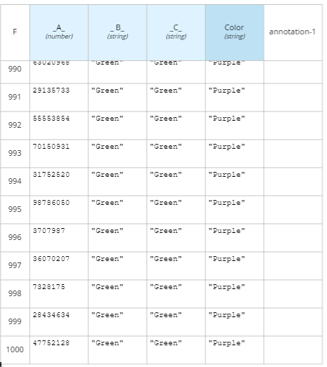
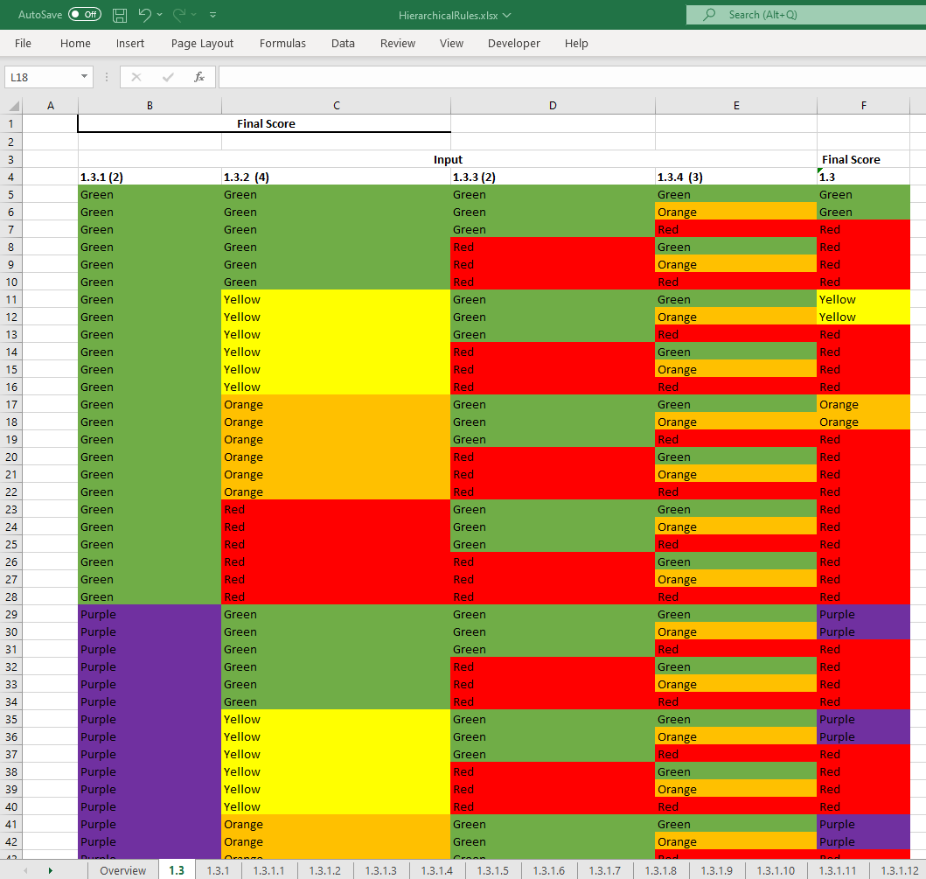
Approaches to Implementing Excel as Decision Tables
Reconvene 11:30 CET

Slide 16
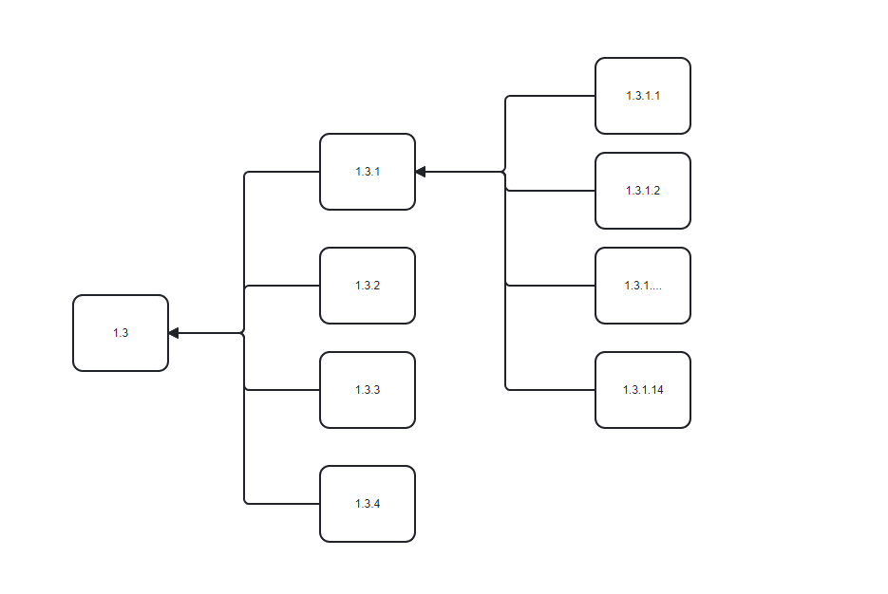
The Rule Spreadsheet
Spreadsheet is maintained by the business and they want to continue maintaining it in Excel, even after rules have been built.

Slide 17
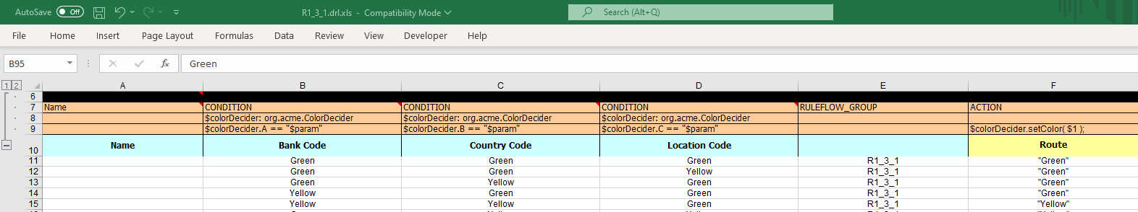
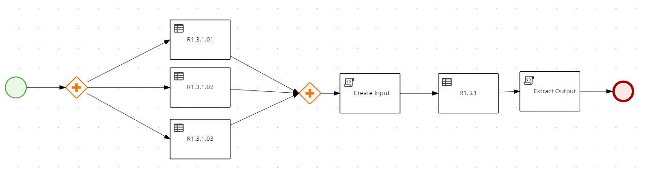
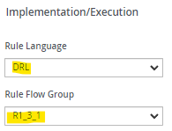
Solution 1: PAM/Excel
Use PAM to invoke each workbook of Excel
Advantage:
Use built in excel functionality
Disadvantages:
Slow to parse (15 mins)
Introduces PAM to rule solution

Slide 18
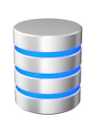
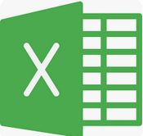
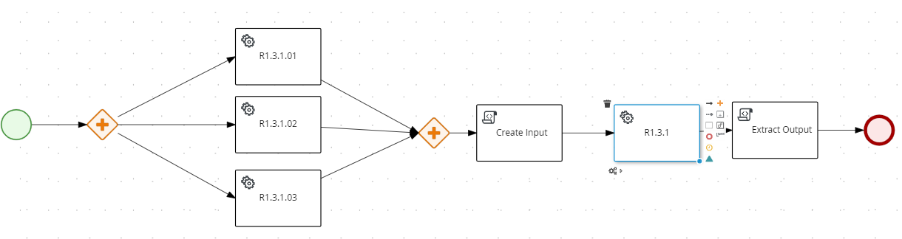
Solution 2: PAM/Database
Database containing
rules
Excel converted to database.
Advantage:
Database efficient and maintainable
Disadvantages:
ETL of spreadsheet
Introducing additional tech (PAM) to rule solution
Additional License cost (PAM)
Additional Database cost
Extract
Transform
Load

Slide 19
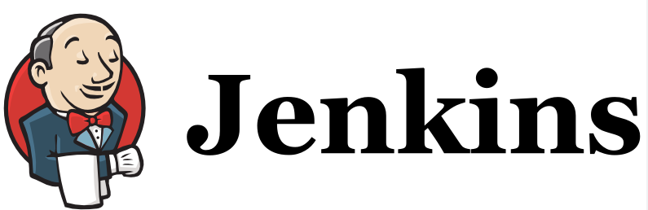
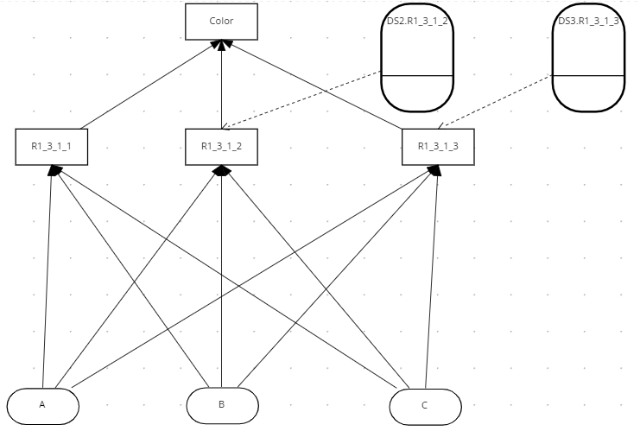

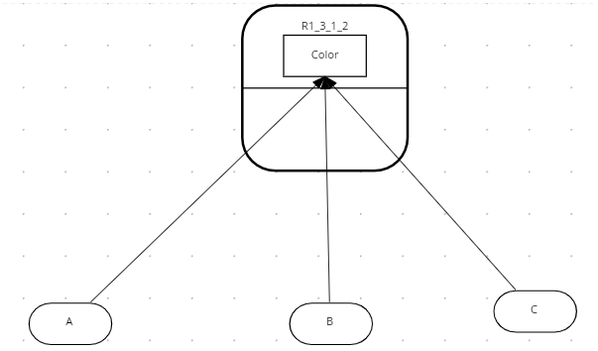
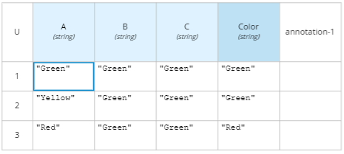
Solution 3: DMN
Advantages
Simplest solution - stays within DM
Preserves Excel spreadsheet.
Business continue to make changes to Excel
Java generator creates DMN from Excel
Generator can be integrated to automated build
Disadvantage
Requires excel to DMN generation
Generate DMN from Excel
Build
Change
Business User

Slide 20
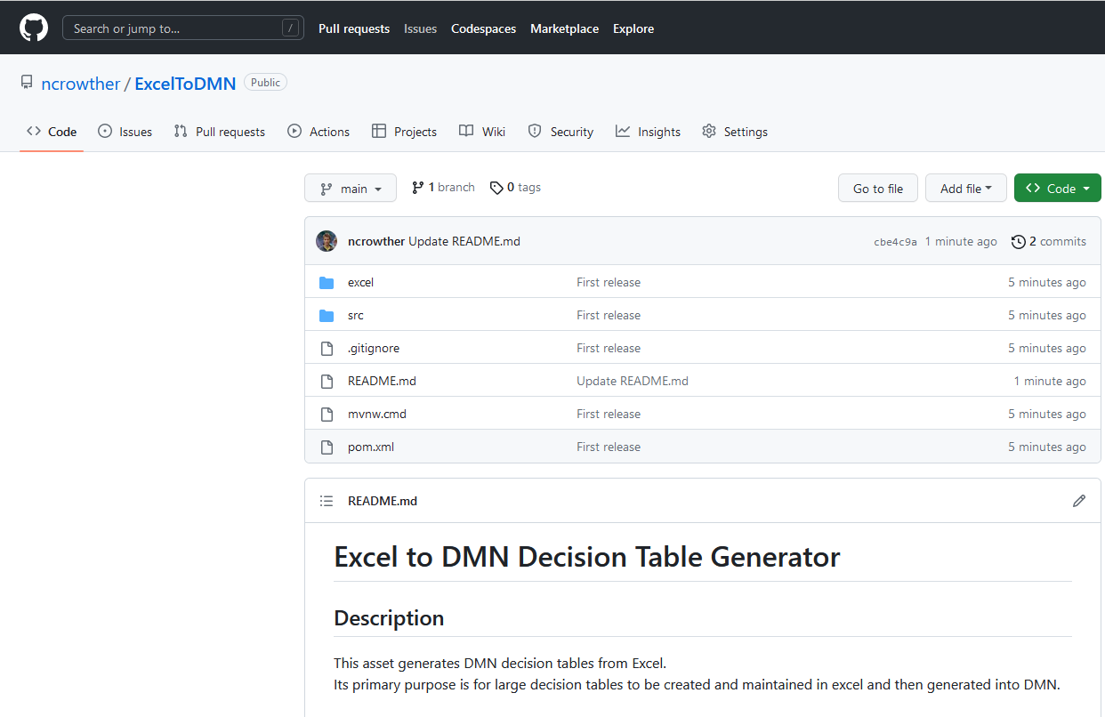
Excel to DMN Asset
A generic asset has been built
https://github.com/ncrowther/ExcelToDMN

Slide 21
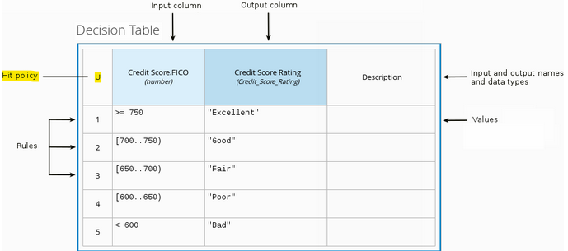
Hit Policies
Hit Policy | Description | When to use
Unique (U) | Permits only one rule to match. Any overlap raises an error. | For detailed reasoning. Ensures your rules cover all cases and are complete
Any (A) | Permits only one rule to match. But allows overlaps. | As above but less strict enforcement of overlaps
First (F) | Rules are evaluated from top to bottom. Rules may overlap, but only the first match counts. | For concise decision tables where a simple go / no go decision is needed rather than complete reasoning.
Collect (C) | Aggregates values in an arbitrary list. | For multiple row matches. String aggregator: <None> - matching instances returned as list Count – Matching instances counted Number aggregator: SUM – matching instances added Count – matching instances counted Min – minimum value Max – maximum value
Notes:
https://ibm.ent.box.com/folder/207663729805?v=2023-05DMNBeyondBasics

Slide 22
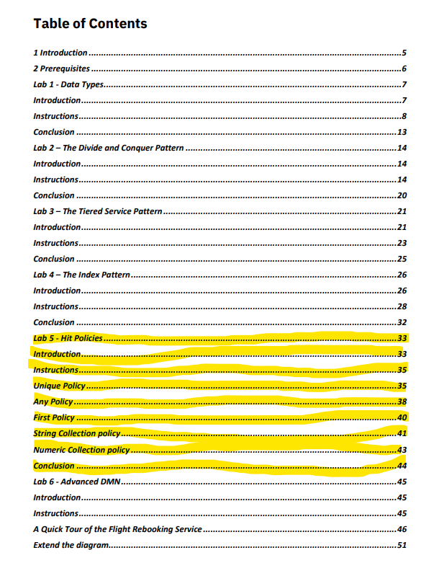
IBM Technical Exchange 11:30 – 12:00 Lab 5 - Hit Policies
In these labs you will learn about decision table hit policies
Reconvene 12:00 CET

Slide 23
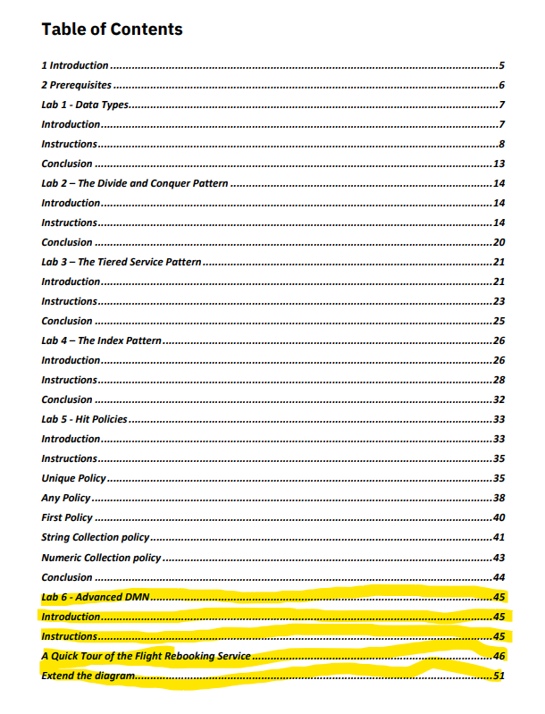
Lab 6
Demo

Slide 24
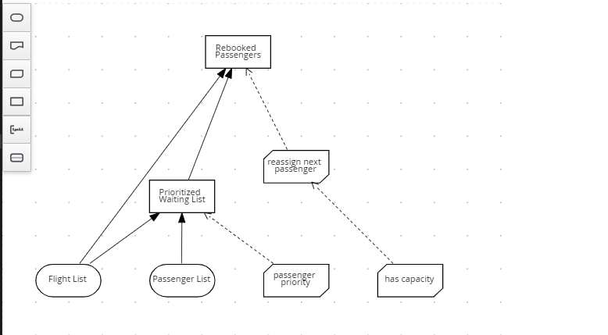
Lab 6 – Advanced DMN
Notes:
https://ibm.ent.box.com/folder/207663729805?v=2023-05DMNBeyondBasics

Slide 25
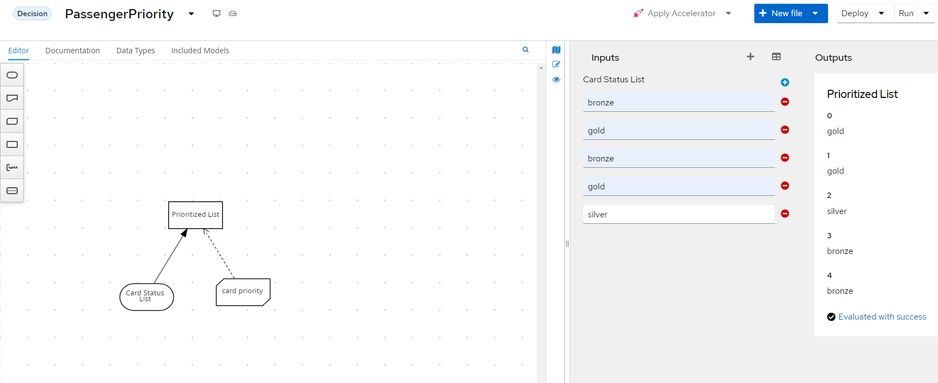
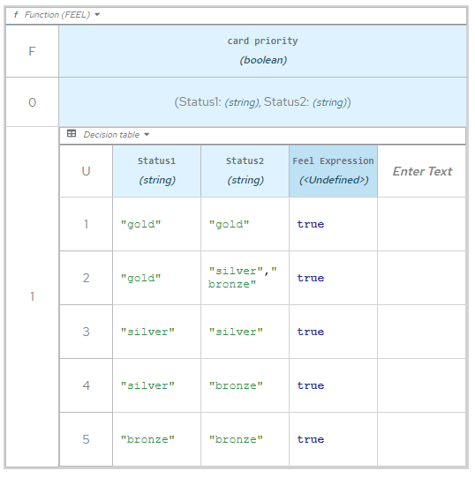
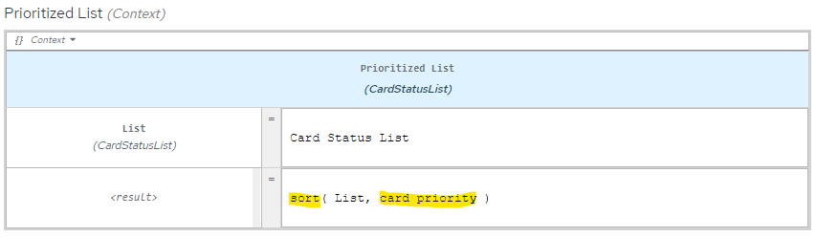
Simplified Lab 6

Slide 26
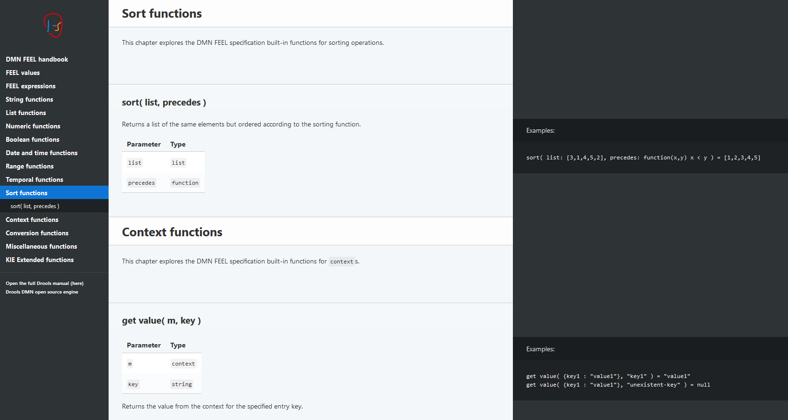
Feel Handbook
https://kiegroup.github.io/dmn-feel-handbook/#dmn-feel-handbook

Slide 27

Q&A

Slide 29
Q & A and Conclusion

Slide 30

IBM Business Automation Community
Join now
Topic group
Open Edition
Forum, blog, articles …
Meet and interact with peers
Stay informed on new product developments
Ask for advice and guidance on a project
Recommend product enhancements
Participate in contests and hackathons
Pick up useful tips and tricks
Learn about upcoming automation events
Build a personal brand as a subject matter expert
Any questions?
Notes:
Finally, anyone can join the IBM Business Automation community to meet and interact with peers, stay informed on new developments, get advice and guidance on projects, recommend product enhancements, learn about upcoming events, and much, much more!
Reference:
Business Automation Community: https://community.ibm.com/automation

